Slide 1
moBILE Programming
6 – Networking

Slide 2
Old Times
AsyncTask
Connect HTTP Protocol - HttpClient
JSON Converter

Slide 3
Networking Libraries
Retrofit - OkHttp
Volley
Fast Android Networking

Slide 4
Volley
HTTP library that makes networking for Android apps easier faster. It is been officially provided by Google as part of AOSP as well as they use it in their inhouse applications such as Gmail, Google News, etc..

Slide 5
Retrofit
Open source networking library developed by Square. The library provides a powerful framework for authenticating and interacting with APIs and sending network requests with OkHttp.
OkHttp is dependent on Okio, which makes it more easier to access and save memory and CPU.

Slide 6
Retrofit
Model POJO (Plain Old Java Object)
Interface Service
Adapter/Call
Converter such as GSON

Slide 7
Model POJO
public class Question {
private String question;
private String url;
public String getQuestion() {
return question; }
public String getUrl() {
return url; }
}

Slide 8
Service Interface
public interface RetrofitRequestService {
@GET("/questions")
Call<List<Question>> ques();
}

Slide 9
Retrofit Adapter
Retrofit mRestAdapter = new Retrofit
.Builder()
.baseUrl("http://your web service rest api")
.addConverterFactory(GsonConverterFactory.create())
.build();
service = mRestAdapter
.create(RetrofitRequestService.class);

Slide 10
Call<List<Question>> call = service.ques();
call.enqueue(new Callback<List<Question>>() {
@Override public void
onResponse(Call<List<Question>> call,
Response<List<Question>> response) {
System.out.println("Question = " +
response.body().get(0).getQuestion());
System.out.println("url = " +
response.body().get(0).getUrl()); } @Override
public void onFailure(Call<List<Question>> call,
Throwable t) { }
});

Slide 11
An Introduction to Volley
Volley is a networking library
Developed by Google
Introduced during Google I/O 2013

Slide 12
Why Volley?
RESTfull Application
History :
Class java.net.HttpURLConnection and org.apache.http.client
Avoid HttpUrlConnection and HttpClient - used On lower API levels (mostly on Gingerbread and Froyo)
HttpClient was deprecated in the last API update (API 22)
And Avoid AsyncTask Too - Honeycomb (API 11)
different from the main thread → NetworkOnMainThreadException

Slide 13
Why Volley?
It's Much Faster
Volley got a score up to ten times better than the other alternatives when used in RESTful applications
It Caches Everything
Volley automatically caches requests
Small Metadata Operations
Volley is perfect for small calls, such as JSON objects

Slide 14
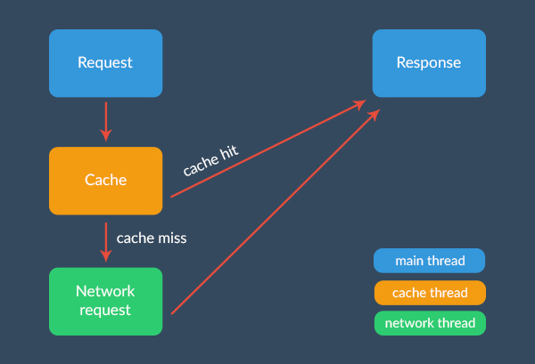
Under the Hood

Slide 15
Getting Started
https://android.googlesource.com/platform/frameworks/volley
dependencies {
...
compile 'com.android.volley:volley:1.0.0'
}
Importing your JAR library in your Android Studio project with a
compile files('libs/volley.jar')

Slide 16
Key Classes of Android Volley
RequestQueue : A Queue containing the Network/HTTP Requests that needs to be made.
Request : A Base Class which contains Network related information like HTTP Methods.

Slide 17
String url = "http://server.id/request";
StringRequest strRequest = new StringRequest(RequestMethod, url, null, new ResponseListener(), new ErrorListener());
Volley.newRequestQueue(this).add(strRequest);

Slide 18
Handling Standard Requests
StringRequest : HTTP Request where the response is parsed a String.
JsonObjectRequest : HTTP Request where the response is JSONObject.
ImageRequest : HTTP Request where the response is Image

